Slide 1


College Logo
Government College Of Engineeing
And Research Avasari
Department Of Computer Engineering
Project On
“Emotion Based Music Recommendation System”
By
Guide Name: Dr.S.U.Ghumbre
Sr no | Name of Team Member | Roll No
1. | Tejashri Shivaji Bachkar | 20221080
2. | Ankita Budhaji Gholap | 20221076
3. | Shubham Jayant Patil | 19121041
Thursday 13 Oct 2022

Slide 2
Project Details
Project Title : Emotion based music recommendation system
Project Domain: AI/ML
Project Group Members:
20221080, Tejashri Bachkar
20221076 , Ankita Gholap
19121041 , Shubham Patil
2

Slide 3
Contents
Introduction to domain & topic
Project Motivation
Problem statement
Literature Survey
Software Requirement Specifications
Project Design
- Project Analysis - UML diagrams - DFD's
Project Planning and Prototyping
Conclusion
References
1

Slide 4
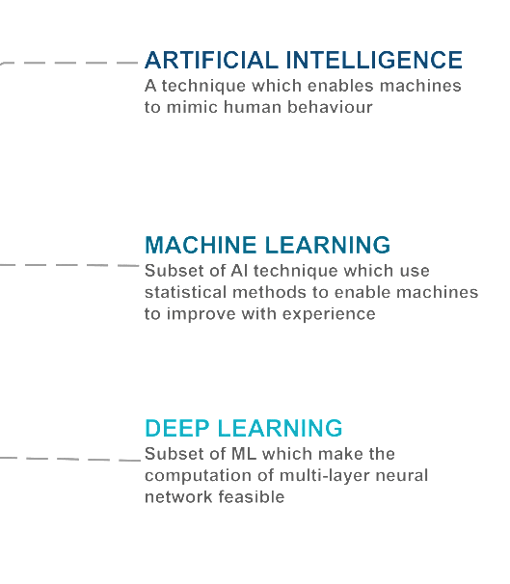
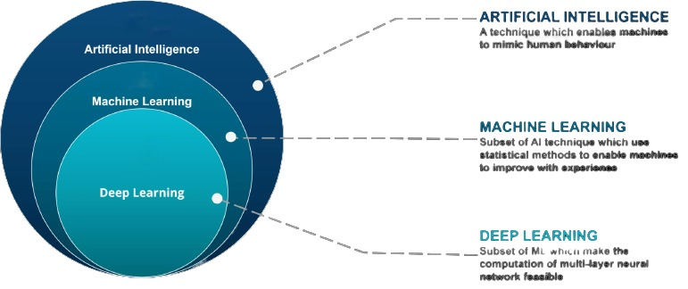
Introduction

Slide 5
Human emotions can be broadly classified as: fear, disgust, anger, surprise, sad, happy and neutral.
We use facial expressions to propose a recommender system for emotion recognition that can detect user emotions and suggest a list of appropriate songs.
Neural networks and machine learning have been used for these tasks and have obtained good results.
OpenCV used for face detection.
CNN algorithm used for image classification and recognition.
2

Slide 6
Motivation
To implement and solve one of the most important problems that no one around notice, music is taking a very huge part of our everyday routine and we choose what to listen to base on many things one of them is Emotions.
Music can reduce your stress levels
Music can influence your mood
Music can improve mental health
2

Slide 7
Problem Statement
To reduce the efforts of users in creating and managing playlist. To develop a system that presents a cross platform music player, which recommends music based on the real-time mood of the user through a web camera using machine learning algorithm.
5

Slide 8
Aim and Objectives of the Project
The aim of the project :
The aim of our proposed system is to provide a music playlist automatically based on current mood of user.
Project objectives :
To detect face using OpenCV.
To extract and classify emotion using CNN.
To recommend music based on emotion detected.
To helps users automatically play songs based on the emotions.
To reduce time and efforts for making manual playlist.
6

Slide 9
Literature Survey
Sr. No. | Reference Name | Work description | Problem found
1. | Emotion recognition using facial expressions (2021) (Paweł Tarnowski, Marcin Kołodziej, Andrzej Majkowski, Remigiusz J.Rak) | This system recognizing seven emotional states (neutral, joy, sadness, surprise, anger, fear, and disgust) based on facial expressions. The characteristics were classified using a k-NN classifier. | Three dimensional model difficult to classify the features of facial expressions.
2. | Music Recommender System for users used on Emotion Detection Through Facial Features.(2021) (Ahlam Alrihaili , Alaa Alsaedi, Kholood Albalawi , Liyakathunisa Syed) | This system recognizing four emotional states. Using PCA algorithm emotion are detected. | Classification and feature extraction is difficult.
9

Slide 10
Sr. No. | Reference Name | Work description | Problems found
3. | Music Recommendation Based on Face Emotion Recognition (2021) (M. Athavle, D. Mudale, U. Shrivastav and M. Gupta ) | Capture image using OpenCV. Haar classifier used for face detection. They create their own song database playlist. | This system does not perform well in bad light conditions and poor camera resolution.
4. | Emotion Integrated Music Recommendation System Using Generative Adversarial Networks (2020) (Mrinmoy Bhaumik, Patricia U Attah , Dr. Faizan Javed) | Classify emotions through using SVM. For music dataset they directly uses spotify API. | They do not point to any definitive conclusion on emotion. There was no statistical significance between the model with or without emotion.

Slide 11
Software: 1) Python 3.6 2) Jupyter Notebook / PyCharm IDE 2021.2 Libraries: 1) OpenCV 3.1 2) Tensorflow 2.10.0 3) Keras 2.8.0 Framework: 1) Flask 2.0.0 Languages : 1) Backend- Python 2) Frontend -JS,HTML,CSS
Software Requirement Specifications

Slide 12
Contents of the Project
Emotion recognisation system
Working of CNN
Music recommendation
Architecture diagram
Use case diagram
Data flow diagram
Application

Slide 13
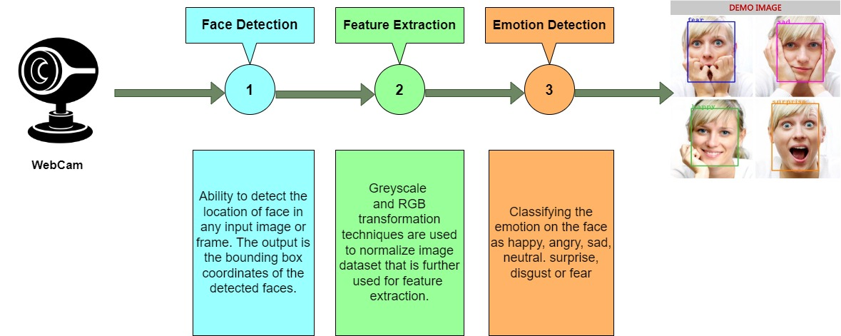
Emotion Recognition System

Slide 14
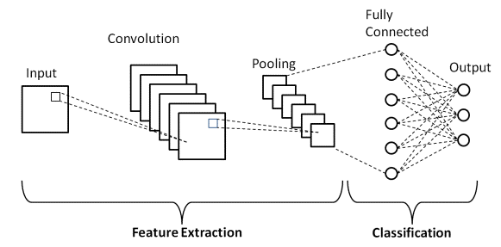
Working of CNN
CNN
Input layer
Hidden layer
Pooling layer
Fully connected layer
Output layer

Slide 15
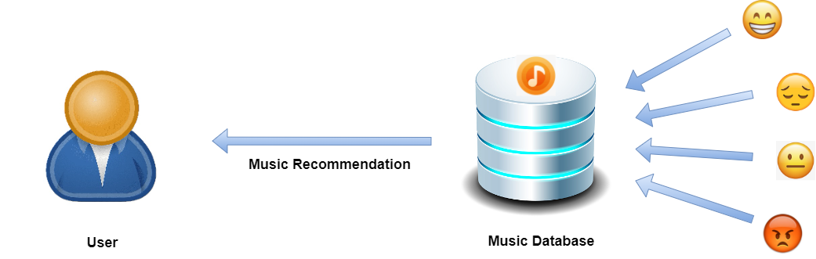
Music Recommendation
System

Slide 16
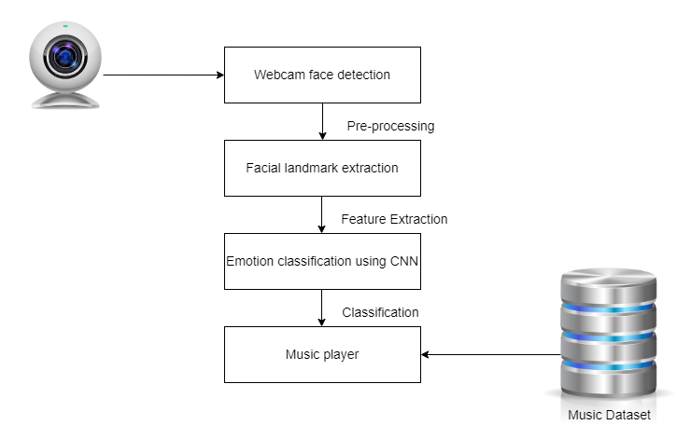
Architecture Diagram
Fig.Architecture Diagram

Slide 17
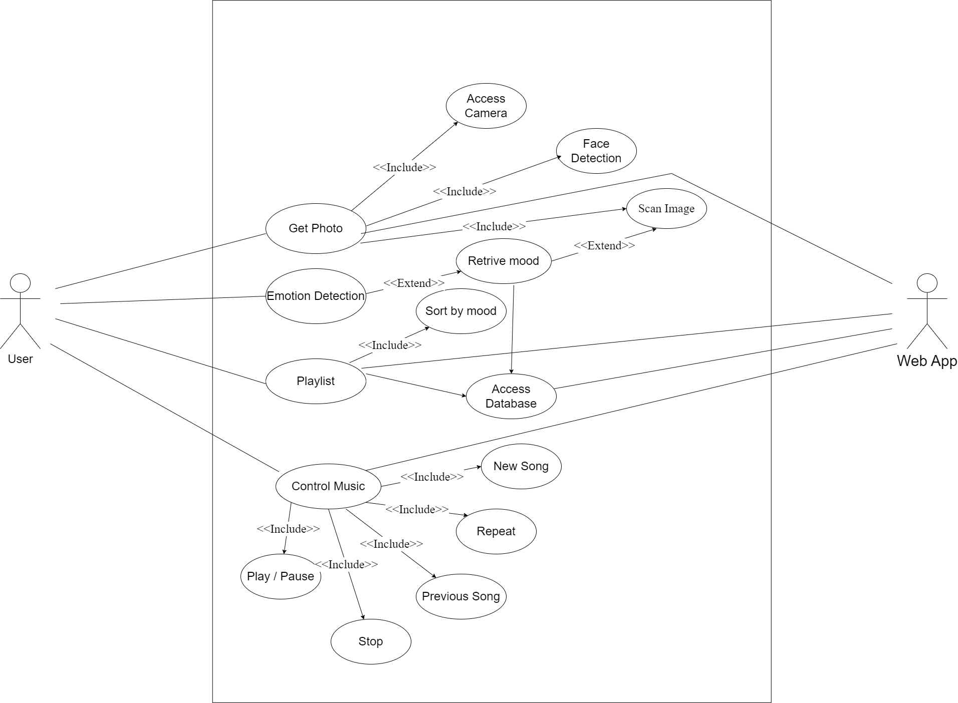
Use Case Diagram

Slide 18
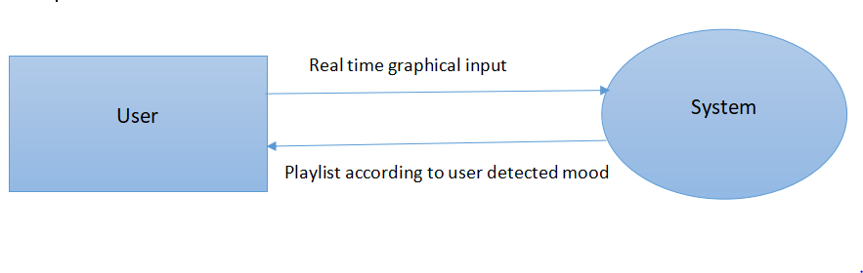
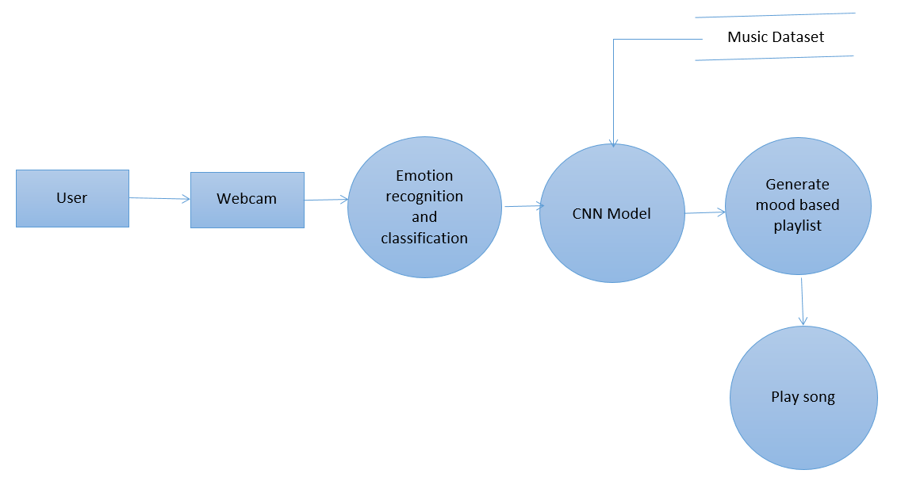
Data Flow Diagram
DFD level- 0
DFD level- 1

Slide 19
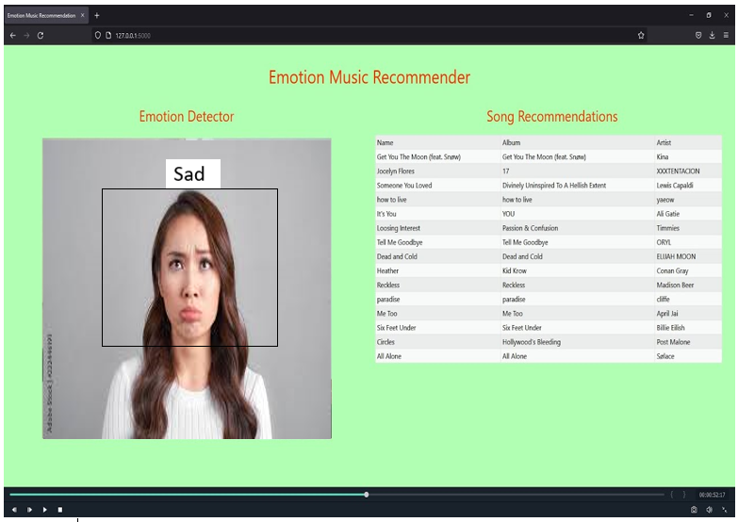
Prototyping

Slide 20
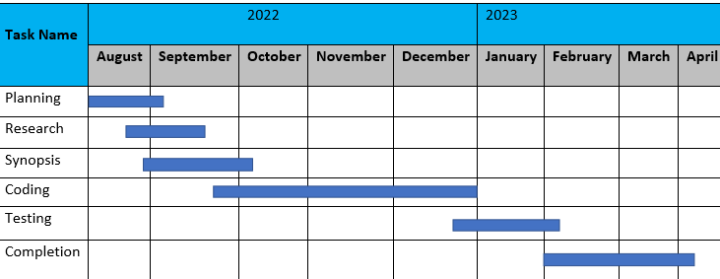
Planning

Slide 21






Applications
Entertainment
Making Car driving safer
Market research
Facial emotion detection
in interview
Testing for video game
Mood setting
11

Slide 22
Conclusion
In this project the emotions can be detect happy, sad, angry, neutral, or surprised.
The music are one that has the power to heal any stress or any kind of emotions.
Thus the proposed system presents Face based emotion recognition system to detect the emotions and play music as per user’s current mood.
12

Slide 23
References
1)Sunil Kumar,Shikha Sharma, “Emotion-Based Music Recommendation System” 2021 [ 9th International Conference on Reliability , Infocom Technologies and Optimization (Trends and Future Direction (ICRITO) , IEEE].
2)H. Immanuel James, J.James Anto Arnold, J. Maria Masilla Ruban , M. Tamilarasan “Emotion-Based Music Recommendation System” 2019 [ International Research Journal of Engineering Technology ] .
3)Ahlam Alrihaili , Alaa Alsaedi ,Kholood Albalawi , Liyakathunisa Syed , “Music Recommender System for Users Based on Emotion Detection through Facial Features”2019 [ 12th International Conference on Developments in eSystems Engineering(DeSE) IEEE ] .
4)Mrinmoy Bhaumik, Patricia U Attah, Dr.Faiza, “Emotion Integrated Music Recommendation System Using Generative Adversarial Networks”[ SMU Data Science Review:Vol.5:No.3,Article 4] .
5)M.Athavle, D. Mudale, U. Shrivastav and M. Gupta,”Music Recommendation Based on Face Emotion Recognition” 2021 [ Journal of Informatics Electrical and Electronics Engineering, 2021].

Slide 24
Thank You!
14

